Slide 1
Styling approach
(CSS, Sass)

Slide 2
What is CSS?
Text
CSS(Cascading Style Sheets) is a language for specifying how documents are presented to users — how they are styled, laid out, etc.
A document is usually a text file structured using a markup language — HTML is the most common markup language, but you will also come across other markup languages such as SVG or XML.
Notes:
Presenting a document to a user means converting it into a usable form for your audience. Browsers, like Firefox, Chrome or Internet Explorer, are designed to present documents visually, for example, on a computer screen, projector or printer.

Slide 3
How does CSS affect HTML?
Text
Web browsers apply CSS rules to a document to affect how they are displayed. A CSS rule is formed from:
A set of properties, which have values set to update how the HTML content is displayed, for example, I want my element's width to be 50% of its parent element, and its background to be red.
A selector, which selects the element(s) you want to apply the updated property values to. For example, I want to apply my CSS rule to all the paragraphs in my HTML document.
Notes:
A set of CSS rules contained within a stylesheet determines how a webpage should look.

Slide 4
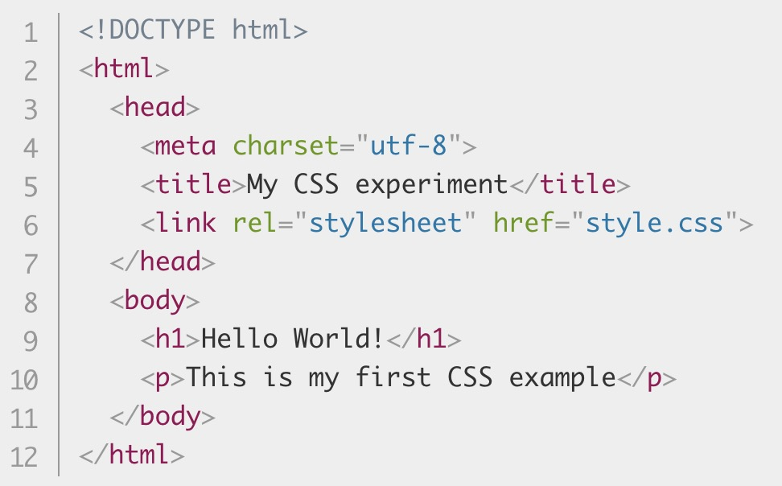
A quick CSS example
Text
First of all, let's take a simple HTML document, containing an <h1> and a <p> (notice that a stylesheet is applied to the HTML using a <link> element):

Slide 5
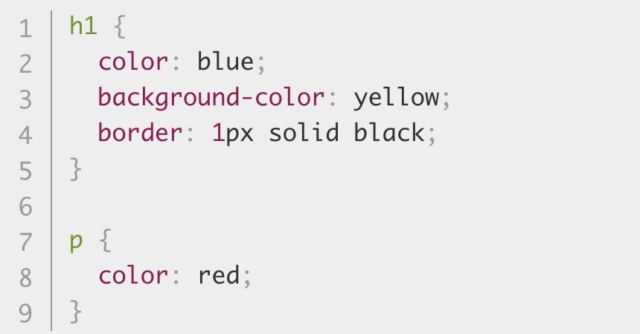
Text
Now let's look at a very simple CSS example containing two rules:
Notes:
The first rule starts with an h1 selector, which means that it will apply its property values to the <h1> element. It contains three properties and their values (each property/value pair is called a declaration):
The first one sets the text color to blue.
The second sets the background color to yellow.
The third one puts a border around the header that is 1 pixel wide, solid (not dotted, or dashed, etc.), and colored black.
The second rule starts with a p selector, which means that it will apply its property values to the <p> element. It contains one declaration, which sets the text color to red.

Slide 6
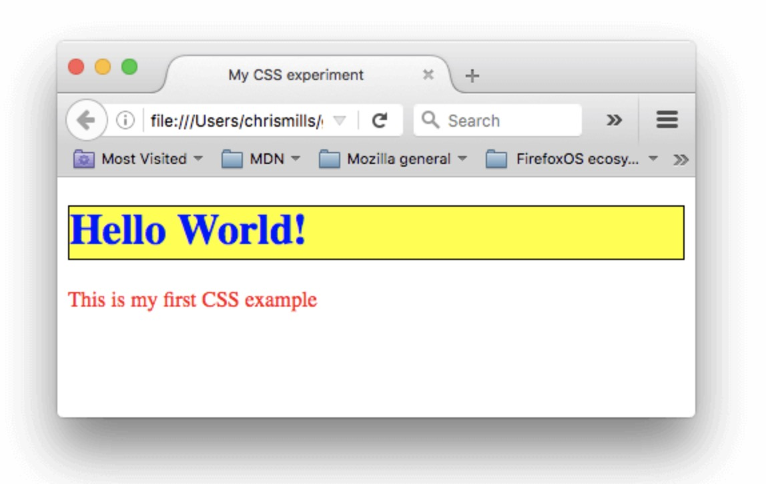
Text
In a web browser, the code above would produce the following output:
Notes:
This isn't too pretty, but at least it starts to give you an idea of how CSS works.

Slide 7
How does CSS actually work?

Slide 8
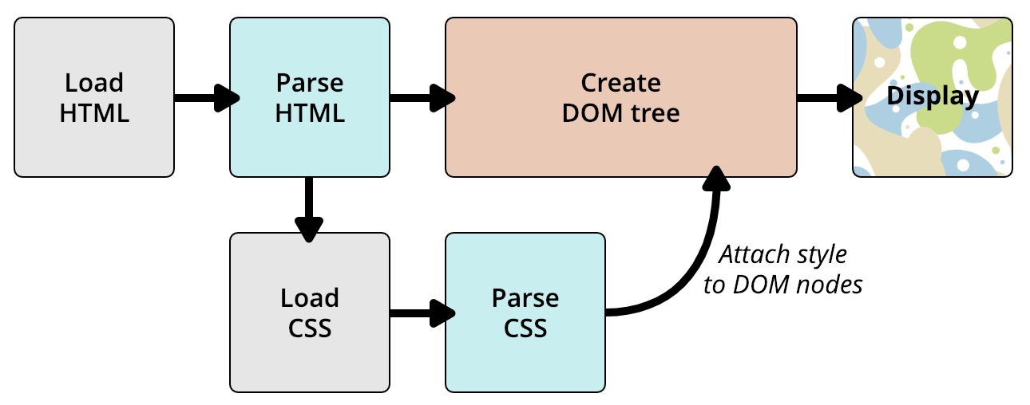
browser displays a document
Text
Notes:
When a browser displays a document, it must combine the document's content with its style information. It processes the document in two stages:
The browser converts HTML and CSS into the DOM (Document Object Model). The DOM represents the document in the computer's memory. It combines the document's content with its style.
The browser displays the contents of the DOM.

Slide 9
About the DOM

Slide 10
Document object model
Text
A DOM has a tree-like structure. Each element, attribute and piece of text in the markup language becomes a DOM node in the tree structure. The nodes are defined by their relationship to other DOM nodes. Some elements are parents of child nodes, and child nodes have siblings.
Notes:
Understanding the DOM helps you design, debug and maintain your CSS because the DOM is where your CSS and the document's content meet up.

Slide 11
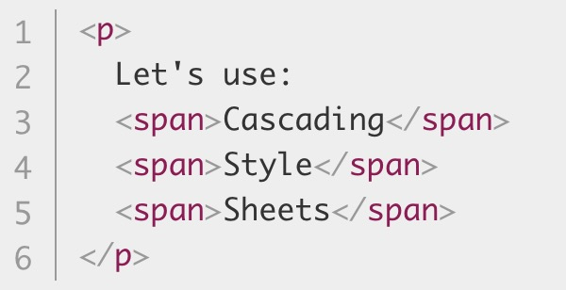
DOM representation
Text
Let's assume the following HTML code:
Notes:
In the DOM, the node corresponding to our <p> element is a parent. Its children are a text node and the nodes corresponding to our <span> elements. The SPAN nodes are also parents, with text nodes as their children

Slide 12
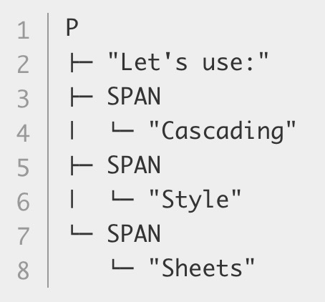
Text
And here is DOM tree as browser see it:

Slide 13
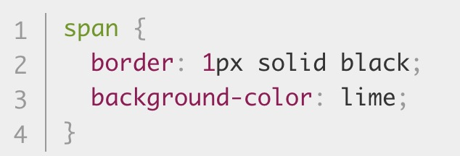

Text
Now lets apply some CSS to it:
Result:
Notes:
The browser will parse the HTML and create a DOM from it, then parse the CSS. Since the only rule available in the CSS has a span selector, it will apply that rule to each one of the three spans.

Slide 14
How to apply your CSS to your HTML

Slide 15
There are three different ways to apply CSS to an HTML document that you'll commonly come across, some more useful than others
Text
External stylesheet
Internal stylesheet
Inline styles

Slide 16
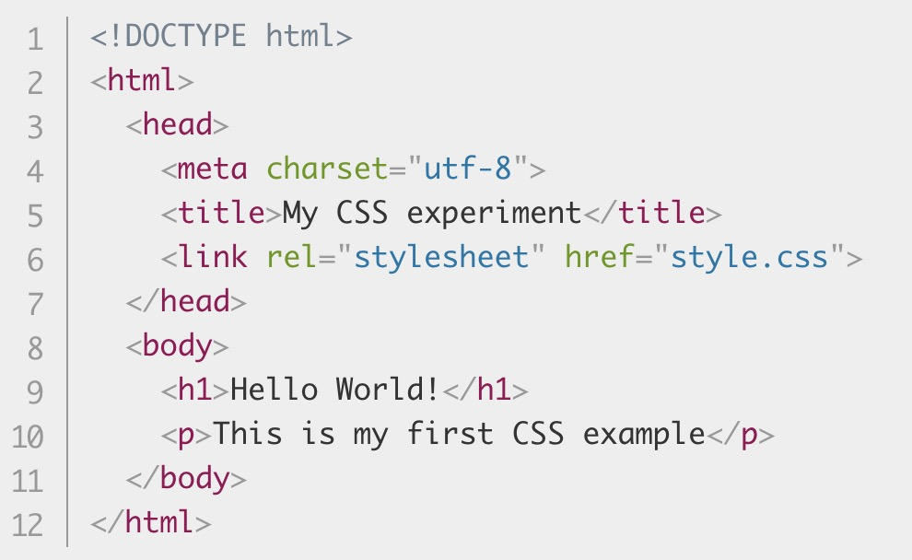
External stylesheet
Text
An external stylesheet is when you have your CSS written in a separate file with a .css extension, and you reference it from an HTML <link> element.

Slide 17
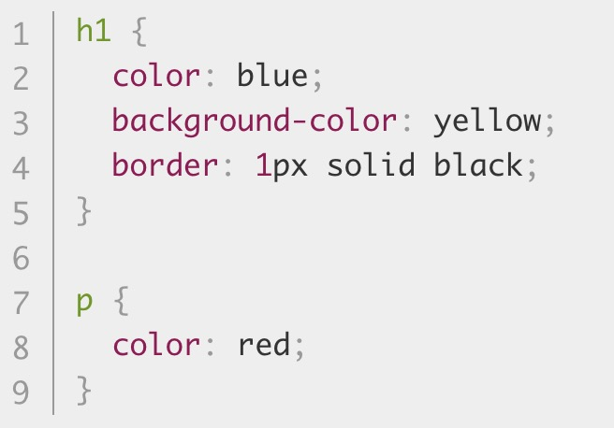
And the CSS file (style.css):
Text
Notes:
This method is arguably the best, as you can use one stylesheet to style multiple documents, and would only need to update the CSS in one place if changes were needed.

Slide 18
Internal stylesheet
Text
An internal stylesheet is where you don't have an external CSS file, but instead place your CSS inside a <style> element, contained inside the HTML head.

Slide 19
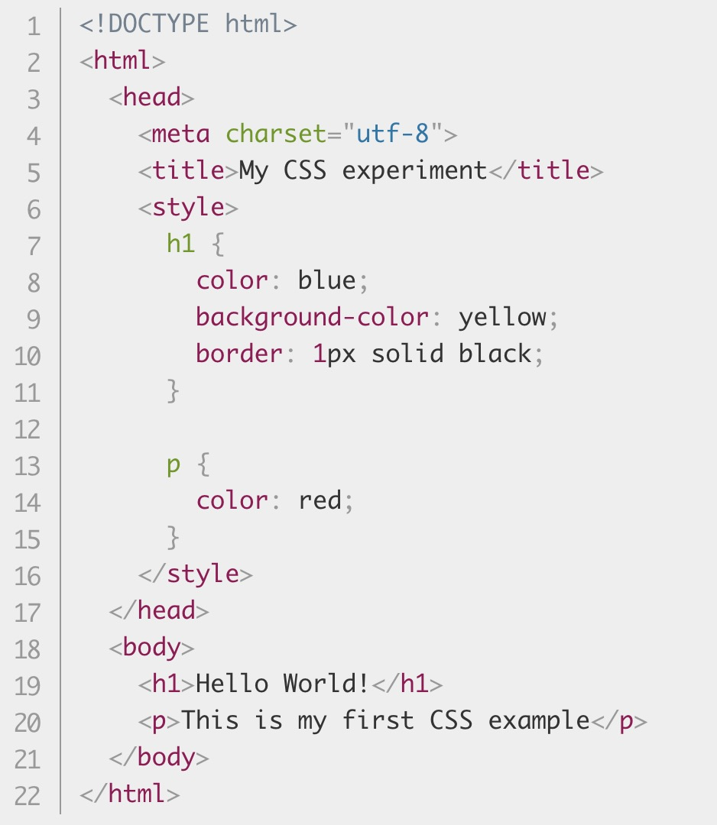
Notes:
This can be useful in some circumstances (maybe you're working with a content management system where you can't modify the CSS files directly), but it isn't quite as efficient as external stylesheets — in a website, the CSS would need to be repeated across every page, and updated in multiple places if changes were required.

Slide 20
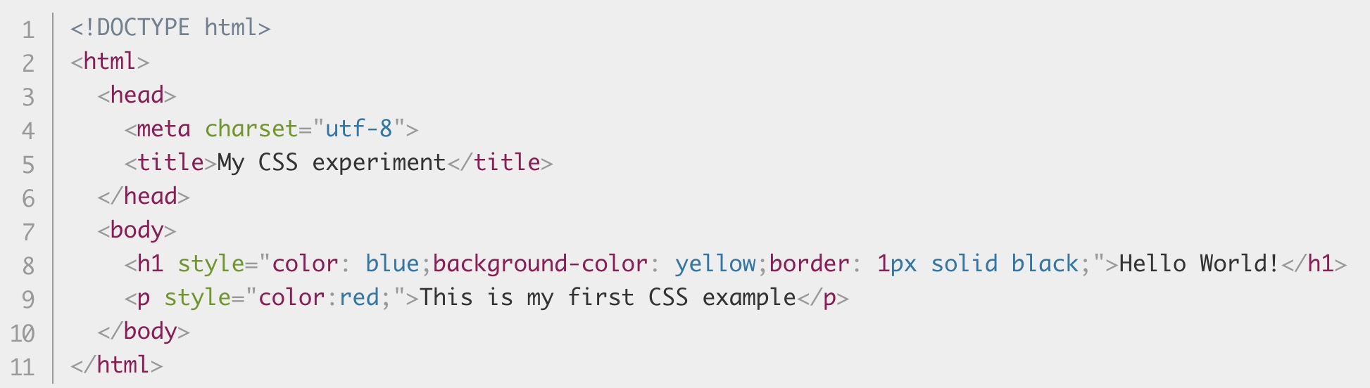
Inline styles
Text
Inline styles are CSS declarations that affect one element only, contained within a style attribute:
Notes:
Please don't do this, unless you really have to! It is really bad for maintenance (you might have to update the same information multiple times per document), and it also mixes your presentational CSS information with your HTML structural information, making the CSS harder to read and understand. Keeping your different types of code separated and pure makes for a much easier job for all who work on the code.
The only time you might have to resort to using inline styles is when your working environment is really restrictive (perhaps your CMS only allows you to edit the HTML body.)

Slide 21
Sass (Scss)

Slide 22
Preprocessing
Text
Sass lets you use features that don't exist in CSS yet like variables, nesting, mixins, inheritance
Once you start tinkering with Sass, it will take your preprocessed Sass file and save it as a normal CSS file that you can use
Notes:
CSS on its own can be fun, but stylesheets are getting larger, more complex, and harder to maintain. This is where a preprocessor can help. Sass lets you use features that don't exist in CSS yet like variables, nesting, mixins, inheritance and other nifty goodies that make writing CSS fun again.
The most direct way to make this happen is in your terminal. Once Sass is installed, you can compile your Sass to CSS using the sass command. You'll need to tell Sass which file to build from, and where to output CSS to. For example, running sass input.scss output.css from your terminal would take a single Sass file, input.scss, and compile that file to output.css.
You can also watch individual files or directories with the --watch flag. The watch flag tells Sass to watch your source files for changes, and re-compile CSS each time you save your Sass.

Slide 23
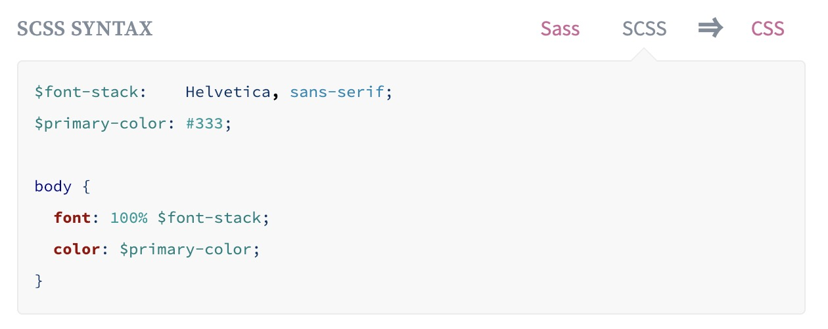
Variables
Text
Notes:
Think of variables as a way to store information that you want to reuse throughout your stylesheet. You can store things like colors, font stacks, or any CSS value you think you'll want to reuse. Sass uses the $ symbol to make something a variable. Here's an example:

Slide 24
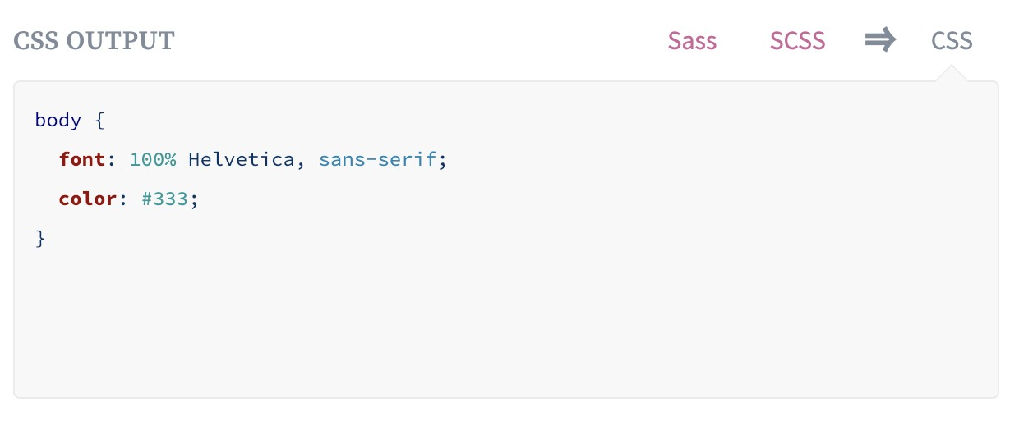
Text
This can be extremely powerful when working with brand colors and keeping them consistent throughout the site.
Notes:
When the Sass is processed, it takes the variables we define for the $font-stack and $primary-color and outputs normal CSS with our variable values placed in the CSS. This can be extremely powerful when working with brand colors and keeping them consistent throughout the site.

Slide 25
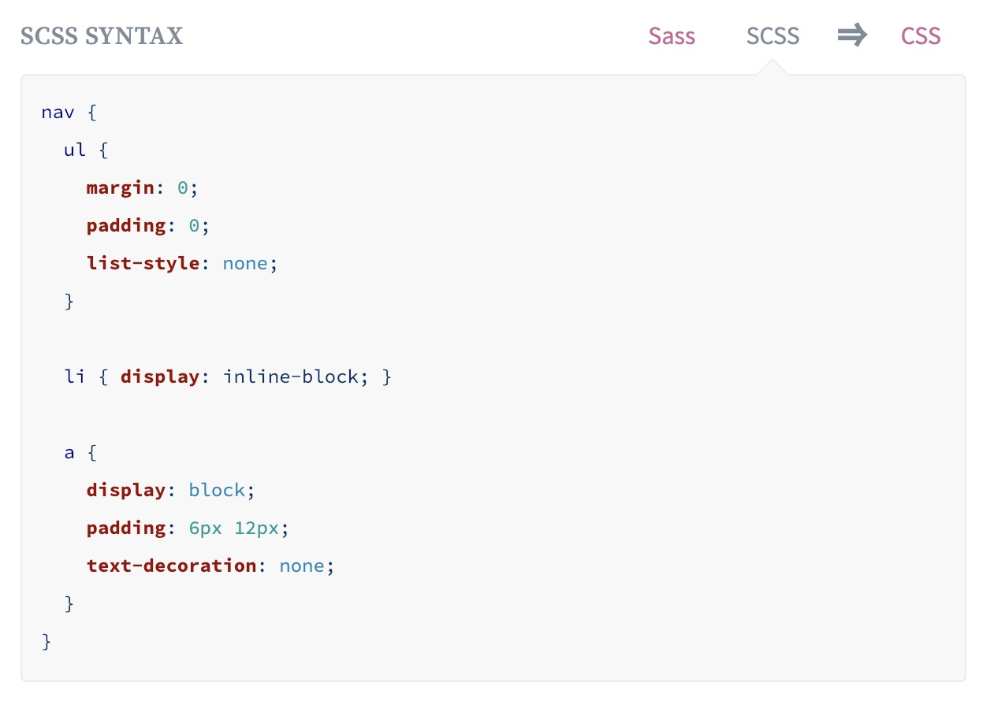
Nesting
Text
Notes:
When writing HTML you've probably noticed that it has a clear nested and visual hierarchy. CSS, on the other hand, doesn't.
Sass will let you nest your CSS selectors in a way that follows the same visual hierarchy of your HTML. Be aware that overly nested rules will result in over-qualified CSS that could prove hard to maintain and is generally considered bad practice.
With that in mind, here's an example of some typical styles for a site's navigation:

Slide 26
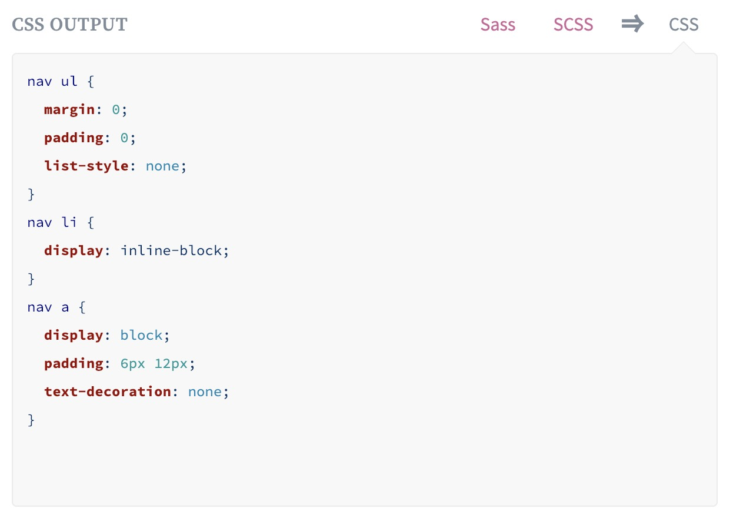
Text
Notes:
You'll notice that the ul, li, and a selectors are nested inside the nav selector. This is a great way to organize your CSS and make it more readable.

Slide 27
Partials
Text
You can create partial Sass files that contain little snippets of CSS that you can include in other Sass files.
You might name it something like _partial.scss. Sass partials are used with the @import directive.
Notes:
This is a great way to modularize your CSS and help keep things easier to maintain. A partial is simply a Sass file named with a leading underscore. The underscore lets Sass know that the file is only a partial file and that it should not be generated into a CSS file.

Slide 28
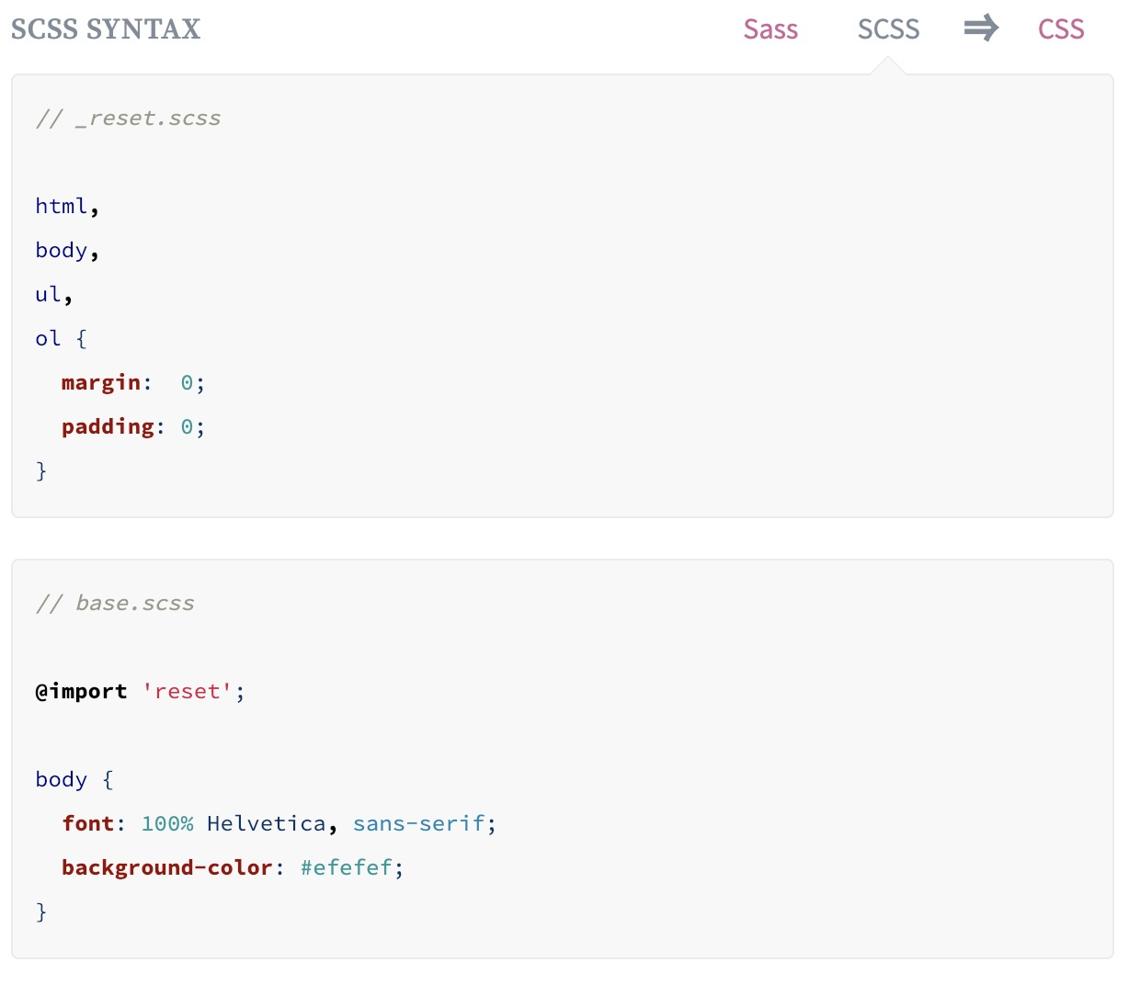
@Import
Text
Notes:
CSS has an import option that lets you split your CSS into smaller, more maintainable portions. The only drawback is that each time you use @import in CSS it creates another HTTP request. Sass builds on top of the current CSS @import but instead of requiring an HTTP request, Sass will take the file that you want to import and combine it with the file you're importing into so you can serve a single CSS file to the web browser.
Let's say you have a couple of Sass files, _reset.scss and base.scss. We want to import _reset.scss into base.scss.

Slide 29
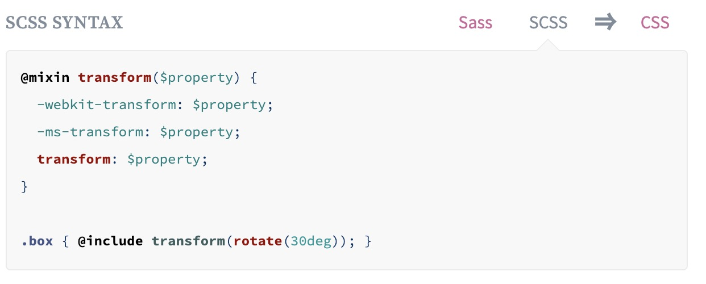
Mixins
Text
A mixin lets you make groups of CSS declarations that you want to reuse throughout your site. You can even pass in values to make your mixin more flexible.
Notes:
Some things in CSS are a bit tedious to write, especially with CSS3 and the many vendor prefixes that exist. A mixin lets you make groups of CSS declarations that you want to reuse throughout your site. You can even pass in values to make your mixin more flexible. A good use of a mixin is for vendor prefixes. Here's an example for transform.

Slide 30
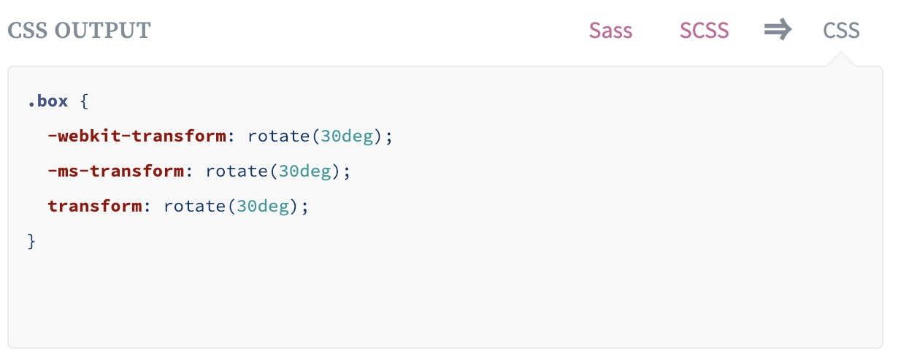
Text
To create a mixin you use the @mixin directive and give it a name
Notes:
To create a mixin you use the @mixin directive and give it a name. We've named our mixin transform. We're also using the variable $property inside the parentheses so we can pass in a transform of whatever we want. After you create your mixin, you can then use it as a CSS declaration starting with @include followed by the name of the mixin.

Slide 31
Extend/Inheritance
Text
Using @extend lets you share a set of CSS properties from one selector to another.
A placeholder class is a special type of class that only prints when it is extended, and can help keep your compiled CSS neat and clean.
Notes:
This is one of the most useful features of Sass. Using @extend lets you share a set of CSS properties from one selector to another. It helps keep your Sass very DRY. In our example we're going to create a simple series of messaging for errors, warnings and successes using another feature which goes hand in hand with extend, placeholder classes. A placeholder class is a special type of class that only prints when it is extended, and can help keep your compiled CSS neat and clean.

Slide 32
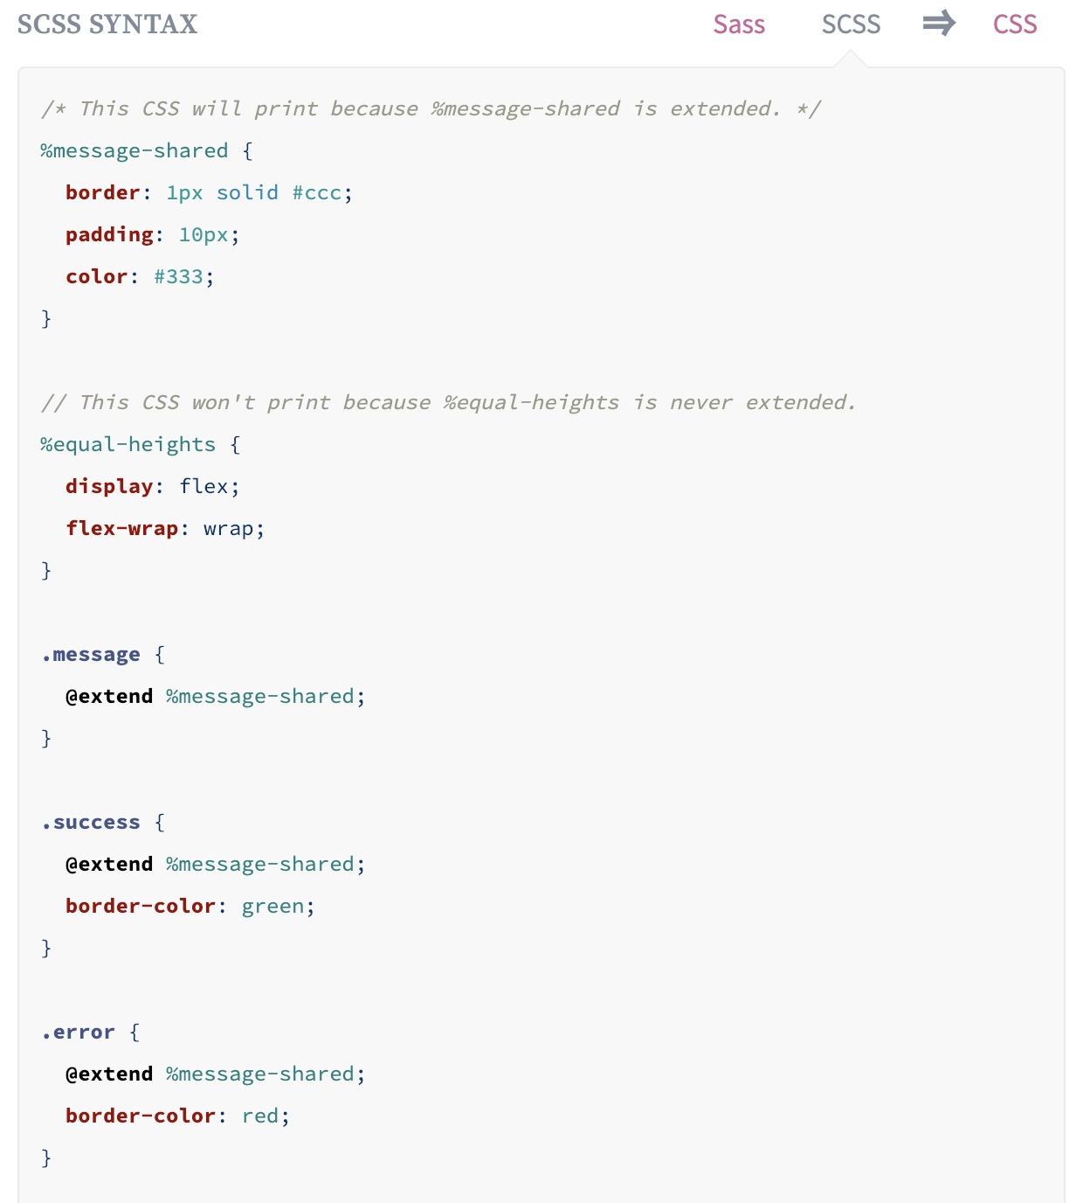
Text
Notes:
What the above code does is tells .message, .success, .error, to behave just like %message-shared. That means anywhere that %message-shared shows up, .message, .success, .error, will too. The magic happens in the generated CSS, where each of these classes will get the same CSS properties as %message-shared. This helps you avoid having to write multiple class names on HTML elements.

Slide 33
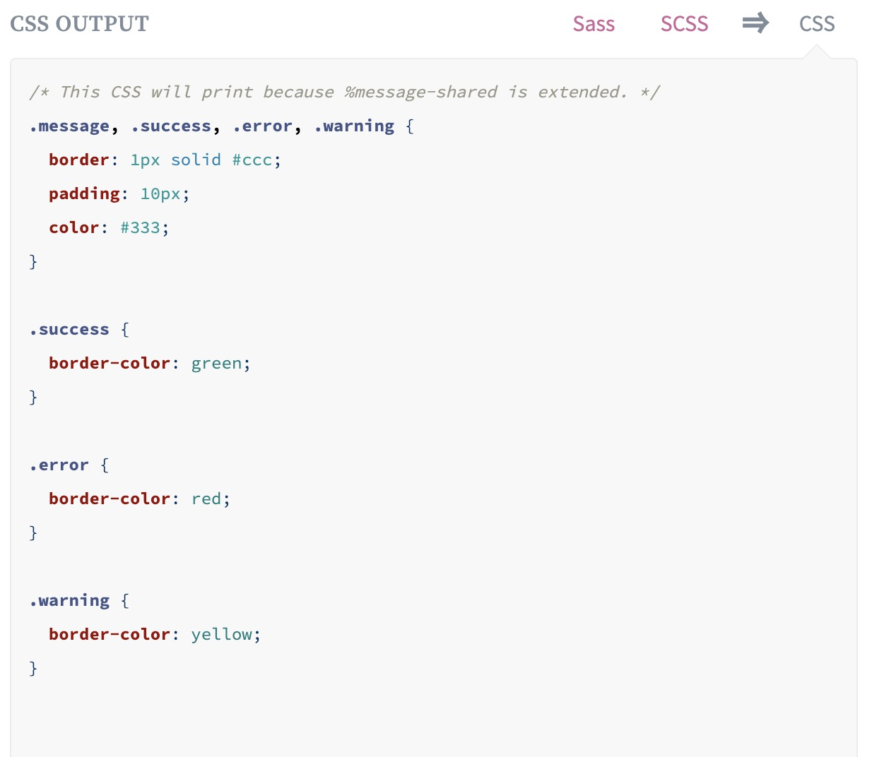
Text
Notes:
You can extend most simple CSS selectors in addition to placeholder classes in Sass, but using placeholders is the easiest way to make sure you aren't extending a class that's nested elsewhere in your styles, which can result in unintended selectors in your CSS.
Note that the CSS in %equal-heights isn't generated, because %equal-heights is never extended.

Slide 34
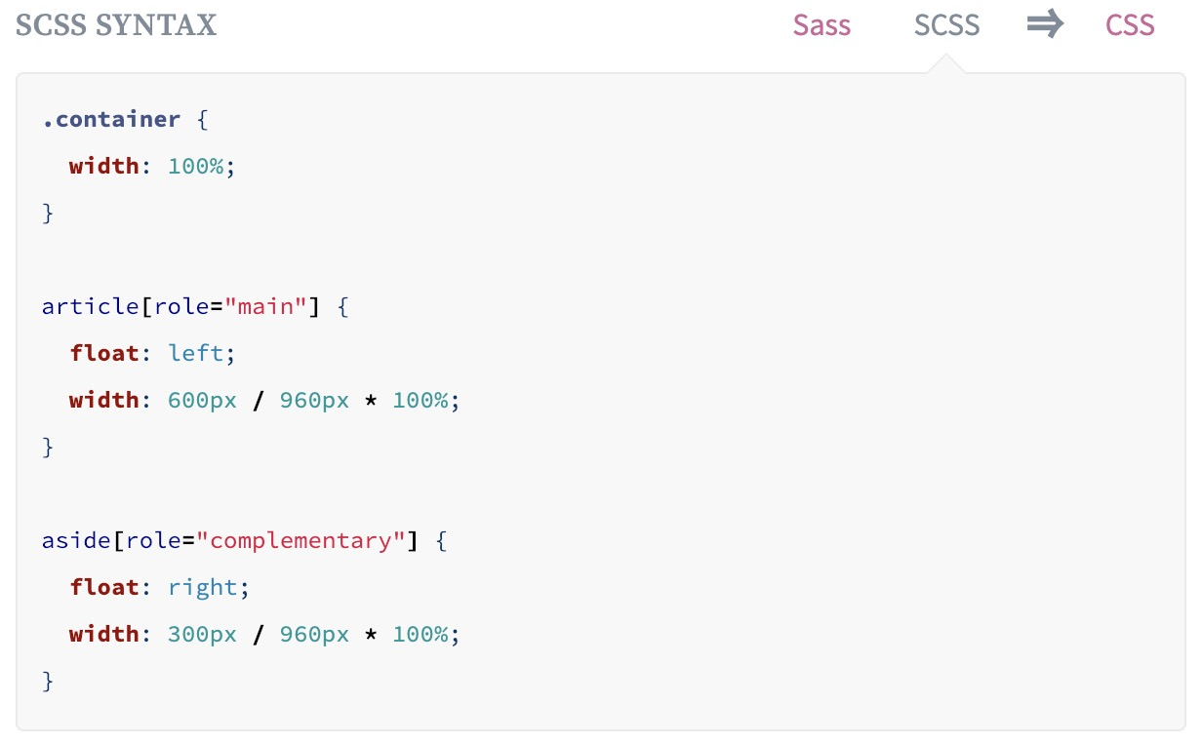
Operators
Text
Doing math in your CSS is very helpful. Sass has a handful of standard math operators like + - * / and %.
Notes:
Doing math in your CSS is very helpful. Sass has a handful of standard math operators like +, -, *, /, and %. In our example we're going to do some simple math to calculate widths for an aside & article.

Slide 35
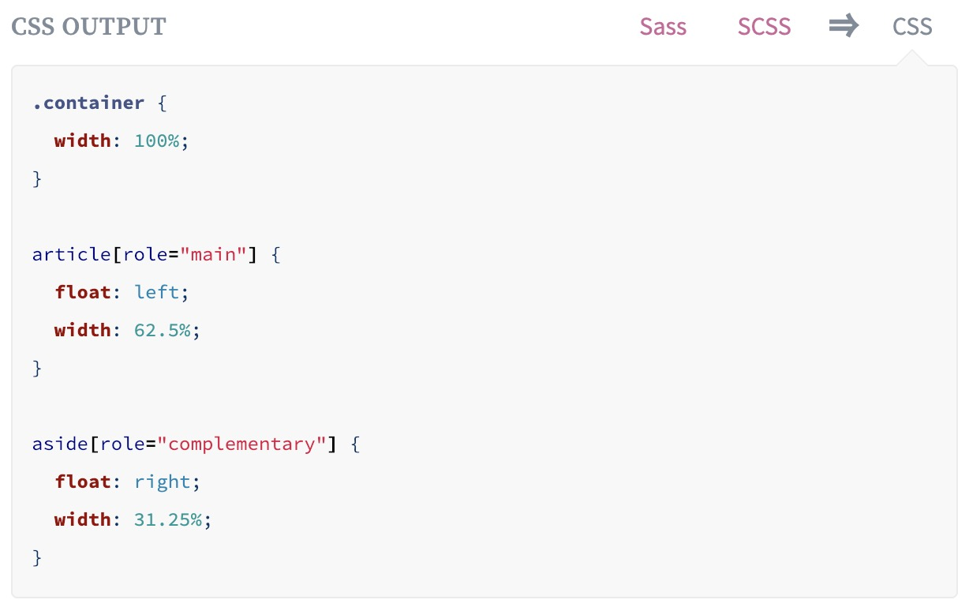
Text
Notes:
We've created a very simple fluid grid, based on 960px. Operations in Sass let us do something like take pixel values and convert them to percentages without much hassle.

Slide 36
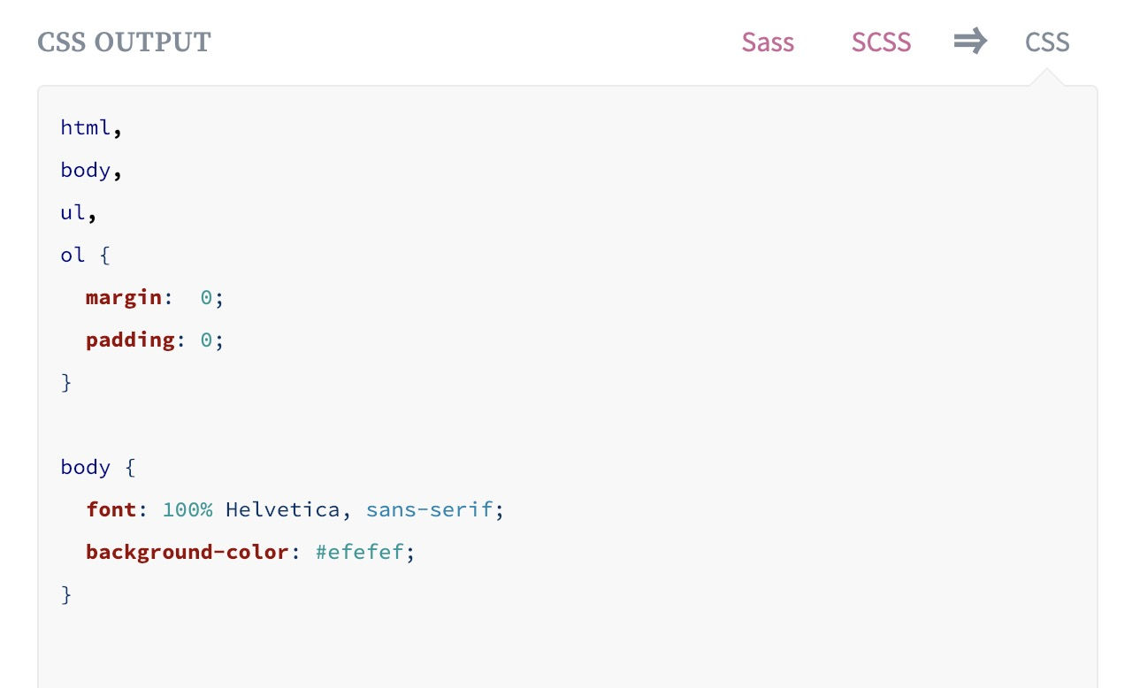
Text
Notes:
Notice we're using @import 'reset'; in the base.scss file. When you import a file you don't need to include the file extension .scss. Sass is smart and will figure it out for you.

Slide 37
styling in React

Slide 38
methods of styling
Text
The methods of styling we will explore are:
Inline styling
Styled Components
CSS Modules
Notes:
Now, we are going to see various ways we can style React components.

Slide 39
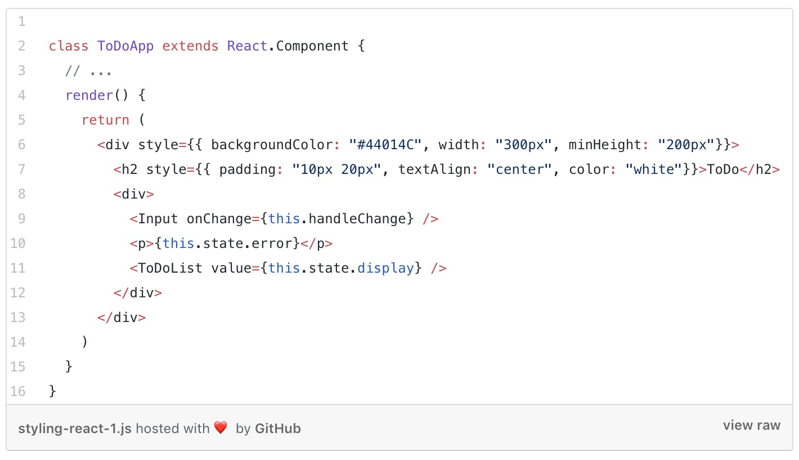
№1 Inline styling of React components
Text
These styles are written as attributes and are passed to the element
Notes:
Now that we are familiar with basic HTML you’ll know that it is possible to add your CSS inline. This is similar in React.
We can add inline styles to React component we want to render. These styles are written as attributes and are passed to the element. Let’s style parts of our component using inline styles:
So we just added inline styles to the outermost div and h2. Here are some things you should note about this.
The first is, there are two curly brackets. What we are rendering is written in JSX and for pure JavaScript expressions to be used in JSX, they have to be included in a curly bracket.
The first curly bracket injects JavaScript into JSX. The inner curly brackets creates an object literal. The styles are passed as object literals to the element.
The next thing to note is that the properties are separated by a comma. It is so because what we are passing is an object. Since it is a JavaScript attribute, the attributes are written in camelCase and not separated by a dashes.
Now in the code above, we just added a few properties to the elements we styled. However, imagine we had to add more and more styles to the element. This is where the inline method breaks down because it will not look clean.
There is a way around this though. We can create object variables and pass it to the elements. Let us do that then.

Slide 40
Creating a style object variable
Text
We create a style object variable same way we create a JavaScript object. This object is then passed to the style attribute of the element we want to style.
Notes:
We create a style object variable same way we create a JavaScript object. This object is then passed to the style attribute of the element we want to style.
So instead of adding the styles inline directly as we did in the previous example, we just pass the object variables:

Slide 41
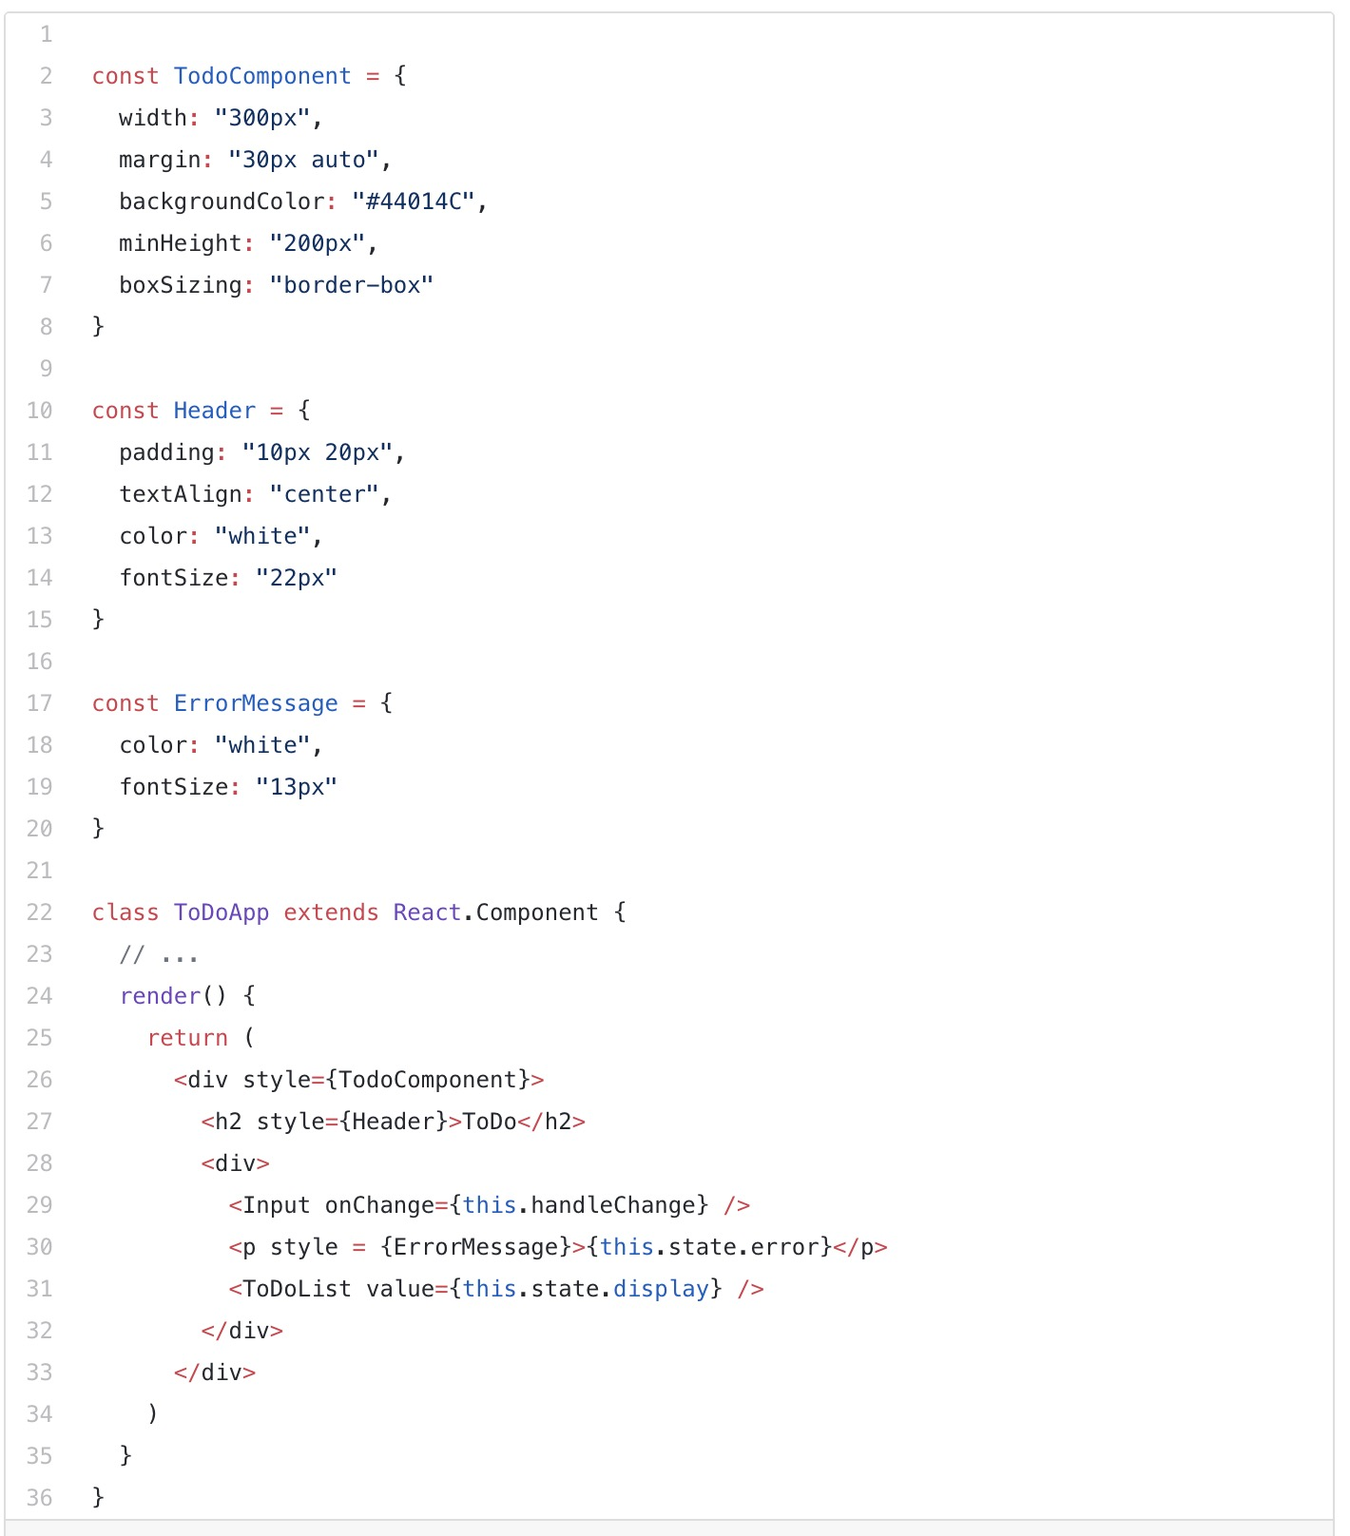
Text
Notes:
In the code above, we created three object variables: TodoComponent, Header and ErrorMessage. We are then passing these variables to the element instead of typing them directly.
💡 We did not have to use double curly brackets in the element because these variables are objects themselves.
If you look at the object properties, the camel cases will be converted to dash separated css attributes during compilation

Slide 42
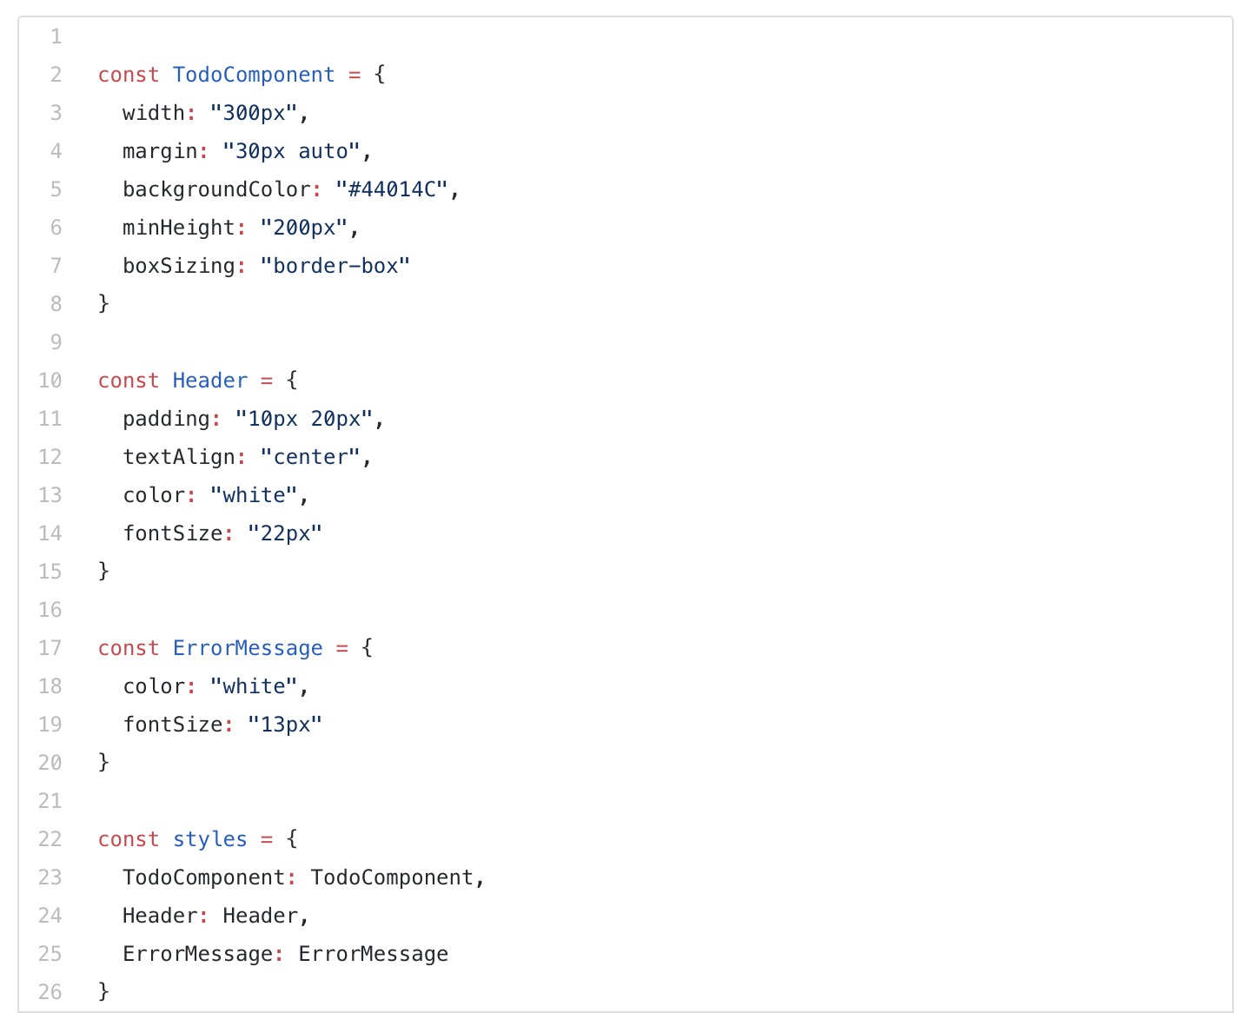
Sharing styles across many components
Text
Notes:
The style objects and the components do not have to be in the same file. We can create a separate js file for our styles, export these styles and then import them into the component where we want to use them. Doing this makes styles reusable across multiple components. Let’s do this for our component.
First, we’ll create a separate js file called styles.js. Then add these styles:

Slide 43
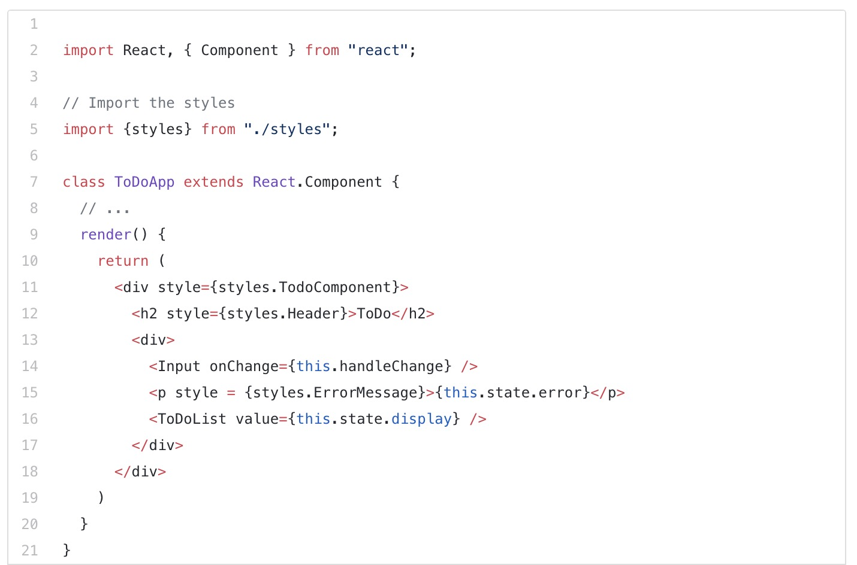
Text

Slide 44
№2 Styled components
Text
With styled components we can write actual CSS in our JavaScript file.
This means that when you’re defining your styles, you’re actually creating a normal React component that has your styles attached to it.
Notes:
This means you can use all the features of CSS like media queries, pseudo-selectors, nesting, etc. in JavaScript.
Styled-components uses ES6’s tagged template literals to style components. With it, the mapping between components and styles is removed.

Slide 45
Text
First, we need to install it.
Then, we need to import it.

Slide 46
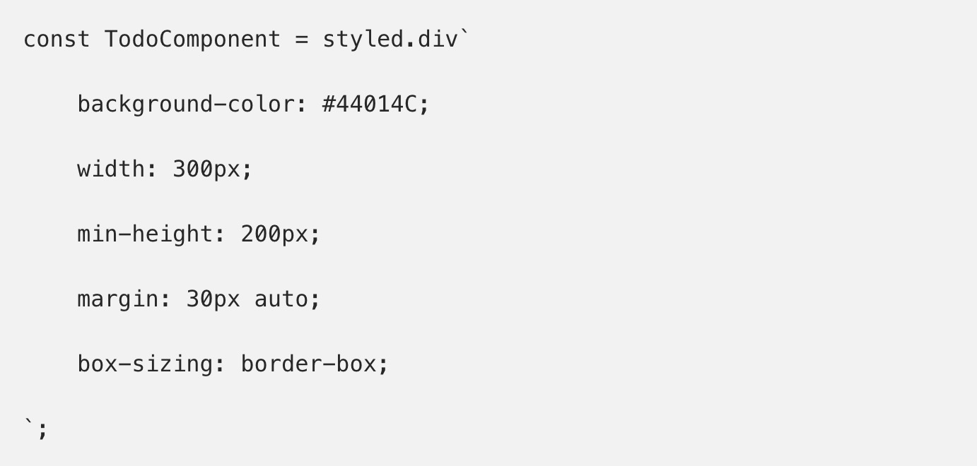
Text
We can start using it right away. We’ll first create a styled component then see how we’ll use it:
Notes:
Above we created a component that can be used the same way any React component. However, notice that we are using pure CSS in a JavaScript file.

Slide 47
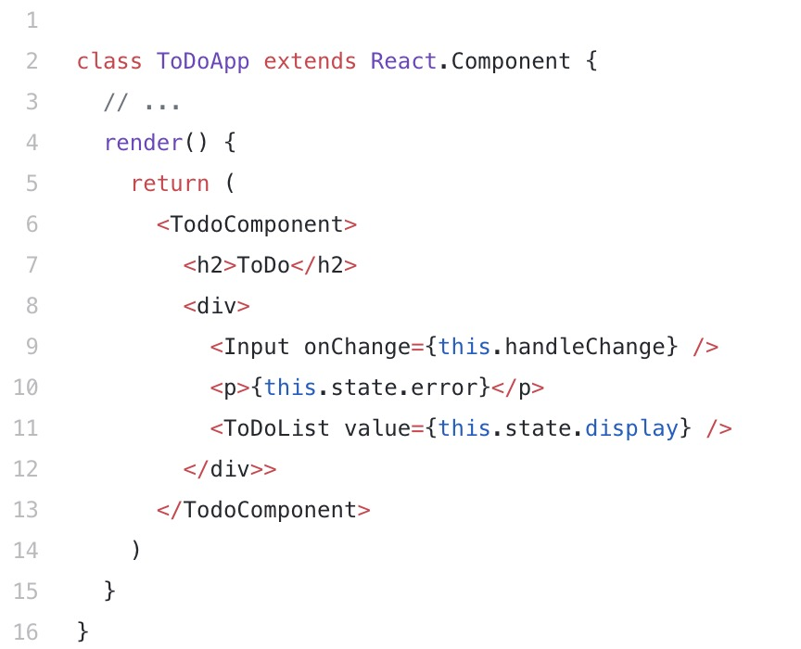
Text
Next, let’s put this component to use:
Notes:
In the code above, we used the styled component we created TodoComponent on line 6 like we’ll use any other HTML element. The only difference is that it comes with its own predefined styles.

Slide 48
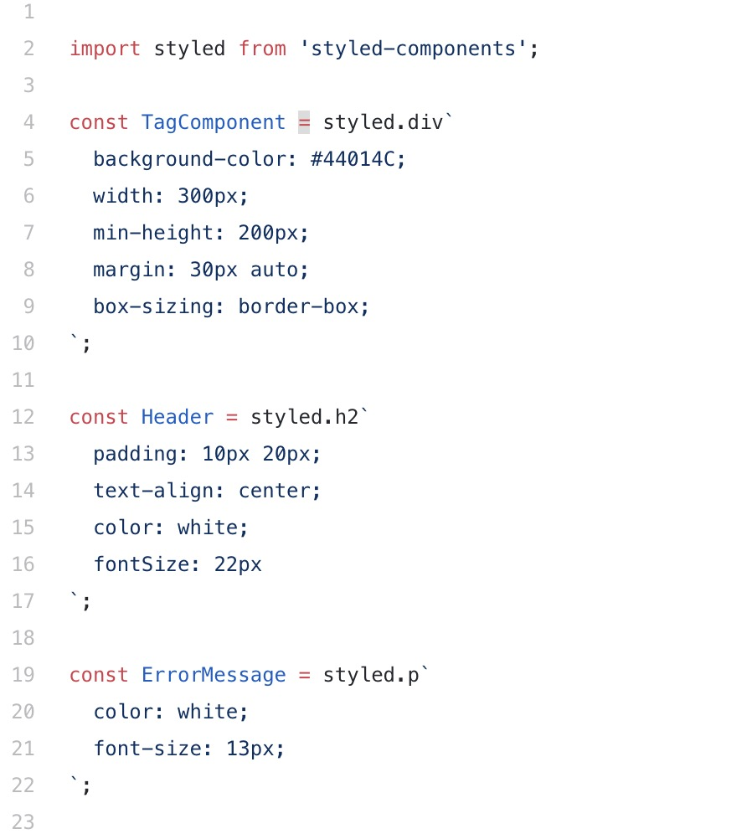
Text
We can do the same for other parts of the component:

Slide 49
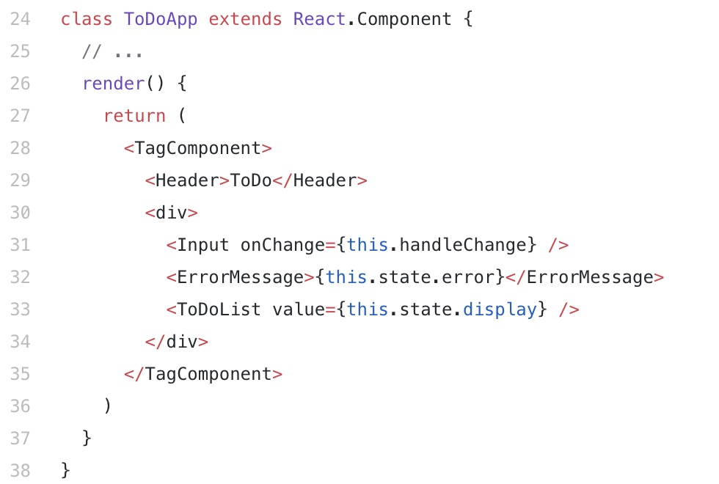
Text
Before: After:

Slide 50
Method #3: CSS Modules
Text
A CSS Module is a CSS file in which all class names and animation names are scoped locally by default.
A CSS Module is basically a .css file that is compiled. When compiled it produces two outputs. One is CSS which is a modified version of input CSS with the renamed class names. The other is a JavaScript object that maps the original CSS name with the renamed name.
Notes:
A CSS Module is a CSS file in which all class names and animation names are scoped locally by default. Take note of the word scoped locally. Let’s break that down a little bit.
CSS class names and animation names are scoped globally by default. This can lead to conflict especially in large stylesheets. One style can be overridden by another. This is the problem CSS modules solves. CSS classes are only available within the component where they are used.
A CSS module is basically a .css file that is compiled. When compiled it produces two outputs. One is CSS which is a modified version of input CSS with the renamed class names. The other is a JavaScript object that maps the original CSS name with the renamed name.

Slide 51
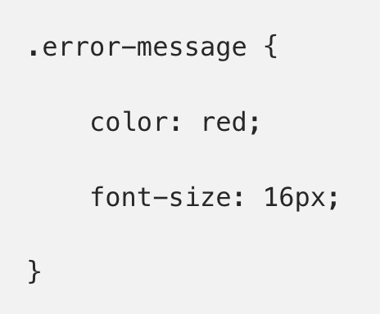
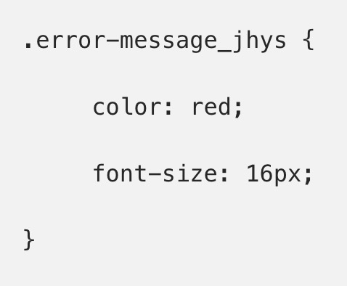
Text
Alright, let’s create a CSS class in a module for a sample error message. The name of our module is styles.css:
Before compilation: Compiled:
Notes:
The added part jhys is just a sample key that is used to uniquely identify this class.

Slide 52
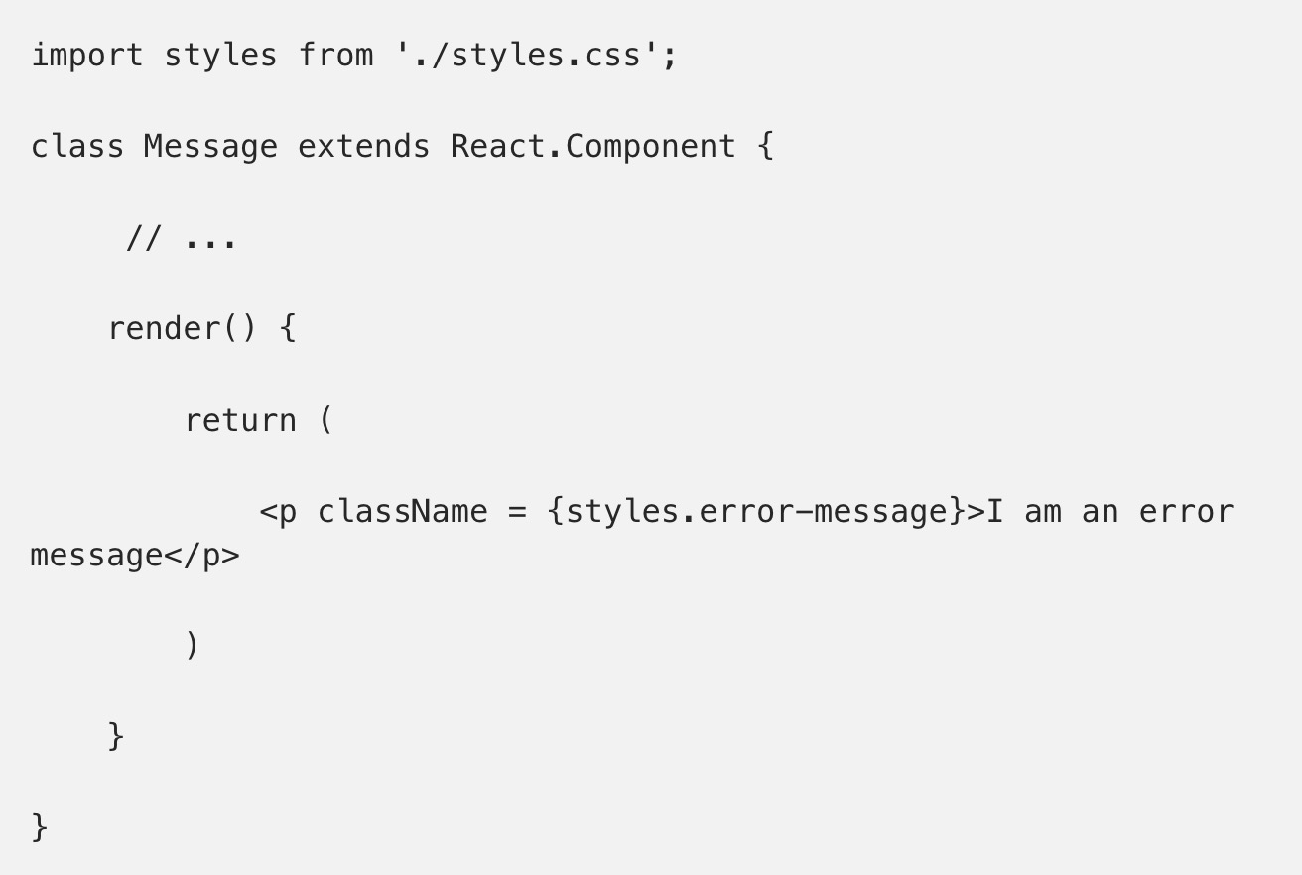
Text
Remember that the main purpose of the CSS modules is to make CSS classes locally scoped and avoid conflicts in naming.

